Slide 1

Digital Transformation
Supporting Material

Slide 2
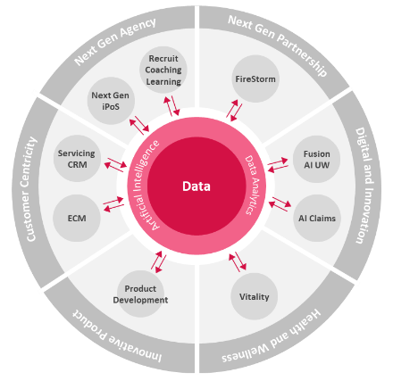
Our Data Vision
Be a Data Centric Organisation
Using data beyond dashboard and reporting
Industrialising AI at scale and making data-driven decision
Increase sales, reduce costs, improve operation efficiency and provide better customer experience
How?
Improve Data Scope in Data Platform
Make Data Available in Real-time
Improve Data Quality
Access Data Easily via Self-serve BI
Bring benefits of AI

Slide 3

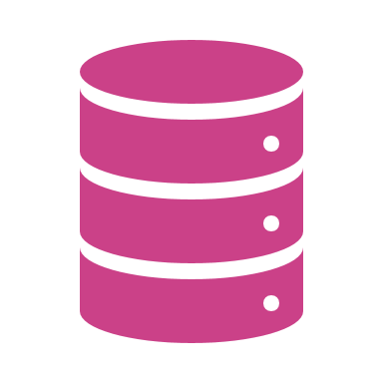







Data Platform : Conceptual
Below is the conceptual representation of the data platform which shows the building blocks and the target business outcomes.
Data Mix
Actionable Insight
The Data platform helps in extracting the value out of data.
The four core elements of the data platform are real-time processing through 24/7 OLTP system(ODS), Big data lake, Business Intelligence and Analytics.
The data platform must have customer 360 which provides a single view of customer across the organization.
The data platform should be able to ingest structured unstructured and streaming data sources to support the core elements.
The data platform must be scalable, highly integrated with other applications, secured and properly governed.
Eventually the goal is to produce actionable insights from the data through the 4 core elements of the data platform, which will improve the business KPI’s (e.g., in the diagram)
Improve Customer Engagement
Integration
Governance
Structured
Real-Time
Processing with 24/7 Core Data Availability with C360
Enterprise Business Intelligence
Improve Customer Retention
Unstructured
Analytics and Artificial Intelligence
Improve Operational Efficiency
Big Data Lake
Integrated Security
Scalable
Streaming
Improve Customer Satisfaction
Manage Risk
Fig. Conceptual Data Platform

Slide 4



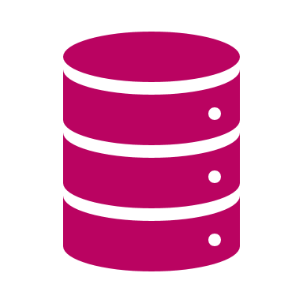









Data Platform : Reference Architecture
Below is the reference architecture to illustrate the different components of the data platform.
API Orchestration
Key Areas of Data Platform Architecture
Source: All data (structure/unstructured) having real business data(except like control, logs, temp) of all the middle office application systems, peripheral systems. External data like social media, public APIs that supporting Analytics.
Ingest : Data Ingestion with minimal data transformation is the process to acquire discrete sets of data and store in the data platform for further processing. The data capture can be real-time or batch.
Process : Processing data to pre-defined schema of C360 to support frond-end application, and Analytic Data Source to support Analytics.
Raw : Data from the source systems with minimal transformation.
ODS (C360 & Replica) : operational data store is the OLTP system to support the digital front-end applications for day-to-day operations with near real time data.
Analytic Data Store (EDW/Data Mart) : Highly scalable historical storage purpose built to support enterprise reporting, predictive and descriptive analytics etc. to help take key business decisions specific to a particular business domain or enterprise wide.
Big Data Lake : This is the area where the data is stored and remains in rest for further processing. This area can store variety of data with varying size , frequency for indefinite period to support Analytics.
Access: This layer enables the end consumption of data.
Analytics: The data analytics platform will enable analysts, data engineers and scientists to examine large and different types of data to uncover hidden patterns, correlations and useful actionable business insights to improve strategic business KPI’s.
Orchestration, Security & Operations: This is the area which manages the overall flow of data moving in different directions, schedules and manage different operational factors like application performance, availability and underlying security etc.
Governance: Governance keeps a track on all the moving and static parts of a data platform like quality, metadata and policies.
Customer
Call Center
Distributer
Partner
Digital Front End
Access
Source/LOB Specific
Cross LOB
Consolidated View
Mirror
Dashboard
Semantic Layer
Relational
Sources
Real-Time CDC
Relational Source Replica
C360
Business Intelligence
Business
User
Change Log
Standardized
Process
Scorecard
Analytic Data Store
Non-Relational Sources
Batch
Change Log
Direct Access
Master/Reference
Data Discovery/Search
Non-Relational Source Replica
Data
Steward
Streaming
Sources
Message Broker
Snapshots
Exploratory
Big Data Store
Self-Service
Real-Time
History
Big Data Lake
Download
Source
Ingest
Raw
Curated
Access
Data Mining
NLP
Data Scientist/Engineer
Predictive Analytics
Analytics
Statistical Analytics
Scheduling
Security
Orchestration, Security & Operations
Integration
Monitor
Metadata
Quality
Governance
Profiling
Policy and Metrics

Slide 5




Building Blocks: Ingestion
Change Data Capture/Real-Time Data Replication
Data must be ingested in near real-time to the cloud platform from the different on-premise and cloud data sources through change data capture. To achieve the same, a data replication tool will be leveraged which is provide an easy integration with various heterogeneous sources without writing proprietary code.
Below is the high-level illustration of the data replication engine.
Build
Administer
Monitor
The data replicate agent needs to be installed in source machine/Server.
For on-premises data sources, the replicate agent will read the change logs from the databases, and not the actual tables.
Depending on the data source(on-premise or cloud), the replicate agent will connect via Express Route or with private end points.
The data replicate client will be used to communicate with the server and will be used to develop the replication jobs, administer it and monitor.
Raw layer to store the exact replica(near real time snapshot) of the source and the change logs as well.
Data reconciliation checking in regular schedule.
Web Client
Express Route
Initial Load
Journals, Redo logs
Replicate Agent
Incremental
Database
On-Premise Sources
Real-Time CDC
Metadata Repository
Private Endpoint
Initial Load
Redo logs
Replicate client
Incremental
Data Lake
Cloud Sources
vNet
Azure
Fig. Change data capture mechanism

Slide 6





Building Blocks : ODS Components and Flow
The ODS is composed of the Raw layer which holds the source system replica in its native data model and the standardized data model(C360) in the Curated layer which is customer centric and source system agnostic.
The highlighted area in the below diagram depicts what we call ODS.
From all relational sources, the data can be moved to Raw layer using change data capture mechanism in real-time and stored in relational storage.
For non-relational sources, the data can be moved to Raw layer in either real-time CDC or batch mode depending on the source type in the data lake which is file-based storage in its original format.
The Raw layer must have a Mirror replica and a change log counterpart of the original source entity.
The mirror replica is the real-time mirror image of the source entity at any given point in time.
From the Raw layer, the change log tables must be used to load the C360 standard database through delta load mechanism.
For digital front-end applications, to enquire near real-time data, the API layer should orchestrate the outputs of C360 which is the customer centric consolidated view across Sources/LOB’s and for Source/LOB specific enquiry, it should point to Raw layer source mirror objects.
The C360 Layer should be built on top of relational.
API Orchestration
Source/LOB Specific
Cross LOB
Consolidated View
ODS
Mirror
Change Log
Standardized
Real-Time CDC
Relational Source Replica
Incremental
C360
Relational
Sources
Micro-Batch
Mirror
Change Log
Real-Time CDC
Batch
Non-Relational Source Replica
Non-Relational Sources
Data Lake
Raw
Curated
Fig. ODS Component View

Slide 7
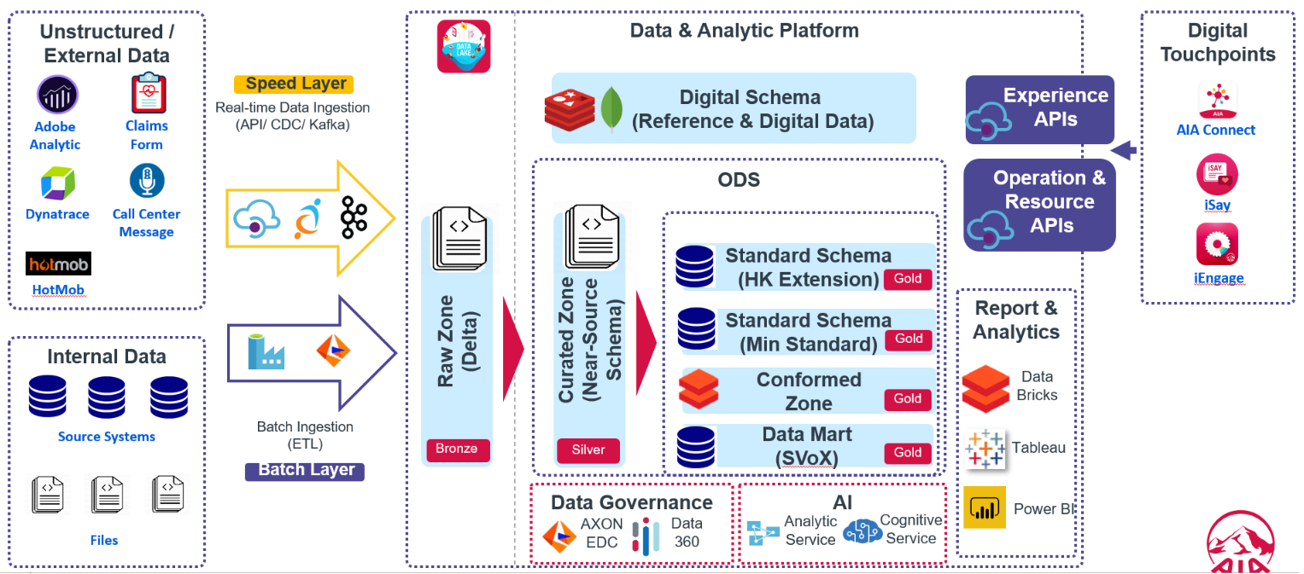
Target State Architecture Diagram
Technology | Layer
Confluent Kafka | Ingestion
Informatica BDM | Process/ Ingestion
Azure Data Factory | Process/Ingestion
Azure Data Lake Store Gen 2 | Storage
Azure SQL DB | Storage
MongoDB | Storage
Tableau | Business Intelligence
Power BI | Business Intelligence
Azure Analysis Services | Business Intelligence
Azure Databricks | Process/Analytics
Azure Cognitive Service | Analytics(AI)
Azure Active Directory | Security (Directory service)
Azure Key Vault | Security (Key management)
Informatica DEI | Orchestration
Informatica EDC | Governance
Data360 | Governance

Slide 8
Data not fed in the charts
Data Platform Current State Summary: as of Q4 2021
Lack of complete data sets as CMLA and AIA data are not integrated resulting in consumption difficulties.
Lack of complete data sets as CMLA and AIA data are not integrated resulting in consumption difficulties.
Lack of complete data sets as CMLA and AIA data are not integrated resulting in consumption difficulties.
57%
Lack of complete data sets as CMLA and AIA data are not integrated resulting in consumption difficulties.
57%
57%
57%
Analytical Data Store
24/7 Data
Availability
(Digital Front-end)
Lack of complete data sets as CMLA and AIA data are not integrated resulting in consumption difficulties.
Data Analytics
57%
Customer 360
Lack of complete data sets as CMLA and AIA data are not integrated resulting in consumption difficulties.
Lack of complete data sets as CMLA and AIA data are not integrated resulting in consumption difficulties.
Data Security
Lack of complete data sets as CMLA and AIA data are not integrated resulting in consumption difficulties.
57%
Lack of complete data sets as CMLA and AIA data are not integrated resulting in consumption difficulties.
57%
57%
Data Ingestion
57%
Data Management
Lack of complete data sets as CMLA and AIA data are not integrated resulting in consumption difficulties.
Lack of complete data sets as CMLA and AIA data are not integrated resulting in consumption difficulties.
57%
57%
Operation Data
Store
Business Intelligence
Platform
Data Variety
Support
Infrastructure

Slide 9
Data Architecture: Target KPI (1/6)
KPI Category | KPI | Definition | Formula | Target | Measurement Evidence | Example
Data Ingestion | Real-Time Data replication | How many data elements are ingested in the data platform from various data sources in real-time | # of tables replicated / # of required source tables | 100%
Data Ingestion | Real-Time Data streaming | How many data elements are streamed to downstream storage or application for further processing in the data platform from various streaming sources in real-time | # of sources streamed / total # of streaming sources | 100%
Data Ingestion | Partner(External) Data Integration | How many partner data sources are integrated bi-directionally between AIA and external partners for analytics and reporting with minimum latency | # of partner data sources integrated/ Total # of partner data sources | 100%
Data Variety | Semi-structured data support | How many semi-structured files are stored and ingested in the data platform from various semi-structured data sources | # of semi-structured files stored in native format in Raw zone/Total # of semi-structured source files | 100%
Data Variety | Un-structured data support | How many un-structured files are stored and ingested in the data platform from various un-structured data sources | # of un-structured files stored in native format in Raw zone/Total # of un-structured source files | 100%
Data Latency | Digital Front-end Data Freshness | How fast is the data made available for the digital front end consumption from OLTP system (Raw, C360/ODS) | Average(Timestamp(Record created in Curated Zone) - Timestamp(Record created in source system)) | <=15 mins
Data Latency | BI Data Freshness | How fresh the data in the BI reports when consumed from Curated layer (EDW/DM) | Average(Current Timestamp - Timestamp(Record created in Curated Layer)) | <=30 mins

Slide 10
Target State Architecture : Risks & Recommendation
Feature
Key Observations
Risk and Recommendation
Analytical Data Store
Risk
Not purposed for an analytical data store and ad-hoc analysis.
No plans to move analytical data store(Data mart/EDW) to MPP databases in cloud.
Cloud Data mart is hosted in the same database as ODS.
Recommendation
Azure Synapse is recommended to be used to host the analytical data platforms(EDW or Datamart).
Plan and Migrate Oracle Data Mart to cloud
The analytical data store compute must be paused in defined periods when not in use.
Currently Data marts exists for enterprise reporting purposes in Oracle(on-prem) and Azure SQL DB/ADLS and is under migration to Azure SQL database.
Data Analytics
Analytics workbench exists and is mainly using Databricks.
No use cases now for real-time analytics.
Recommendation
Follow recommendations for data analytics from reference data architecture document.
Azure Databricks is preferred for analytics and machine learning platform with Azure ML and ML Flow for training model management and deployment.
AKS clusters are recommended for production deployment for models exposed as web services for real-time predictions.

Slide 11



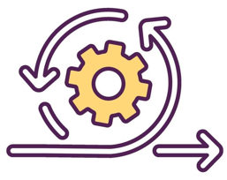

TBD
Key Challenges
Customer 360
(Single view of Customer)
Integrated Analytical Platform
Infrastructure
Readiness
Exploration and Self-service
Continuous Integration/Delivery/Training
Partner Data
Integration
Source of customer data is not exhaustive across LOB.
Limited integration with external and 2nd party customer data.
Lack of industrialized Customer API to support different channels.
Lack of customer centric data model to support front-end channels.
Lot of complex transformation done prior to making data available for consumption. This is mainly due to feeding the complex ADAM model.
Lack of an integrated workbench for data scientists for experimentation within the data platform
Too many data silos due to lack of data discoverability and domain expertise.
Lack of production quality data for ML training.
Lack of real-time and streaming analytics for application workflows and real-time prediction dashboards.
High turnaround time for Infra provisioning and access management.
Mix of modern and traditional technology stack
Many countries still in on-premises with limited on-demand storage and compute scalability
Unpredictable performance of data pipelines and APIs due to unpredictable data traffic.
No defined technology workbench for data exploration for data stewards and end users.
High dependency on IT to share data to different business departments, which creates silos and increased costs.
Lack of enterprise level data catalogues for easy data search and discovery.
Dependency on IT for data wrangling intended for data analysts, scientists.
No defined framework for bulk data sharing between for analytics and reporting between AIA and partner entities in a scalable and secured manner.
The turnaround time and cost to ingrate with partners is quite high with mostly file based batch integration which is not efficient when the data size starts growing.
No defined methodology for CI/CD for data engineering pipelines.
No defined methodology for CI/CD and continuous training for machine learning models.
Lot of manual deployments for data curation pipelines(engineers) and analytical pipelines
Inadequate Customer Engagement
Limited Actionable Insights
Decreased Customer Satisfaction
Reduced Productivity
Time to Market Delays
Reduced Business Opportunities

Slide 12

Current vs Target State
Current
Target: FY 2023
Architectural Component Maturity

Slide 13
TBD
Key Action Points and Focus Area : FY 2022-23
1
2
3
Define de-duplication business logic as well as fuzzy logic based on the various customer data points.
Enhance customer data integration for social media, 3rd party sources along with Insurance core data from different LOB to create a 360 persona of the customer which can serve various operational purposes (Ops, Distribution, Marketing etc.)
Define generalized Customer API attributes based using top-down approach (i.e., define API attributes based on consuming applications rather than the source applications. Based on the API definition, build a generalized and reusable customer data model.
4
Define standard product suit which can fulfill Customer 360 requirements out of the box or minimal customization.
Customer 360
(Single view of Customer)
1
2
4
Define organization level data persona’s who will consume the data for different needs with varying level of technical and functional skills.
For e.g., Super users, Department leaders, data analysists, business analysts, data scientists, Data engineers, Citizen users with their preferred skillsets
Define data classification protocol to distinguish general, confidential data to have different access controls based on personas.
Define the technology framework based on the defined personas, which will enable end-users, data stewards to search the data, upload/download data, run queries(e.g., SQL) on Data lake, get statistics of the data and perform data transformation in a secured manner. The framework must ensure it natively connects to all enterprise data stores and most importantly must not interfere with production workloads.
3
Define data catalogue mechanism to ensure metadata is accessible and the data doesn’t get lost over time. All users can easily access the catalogue to understand what data is there and where it can be found.
Exploration
and Self-service

Slide 14



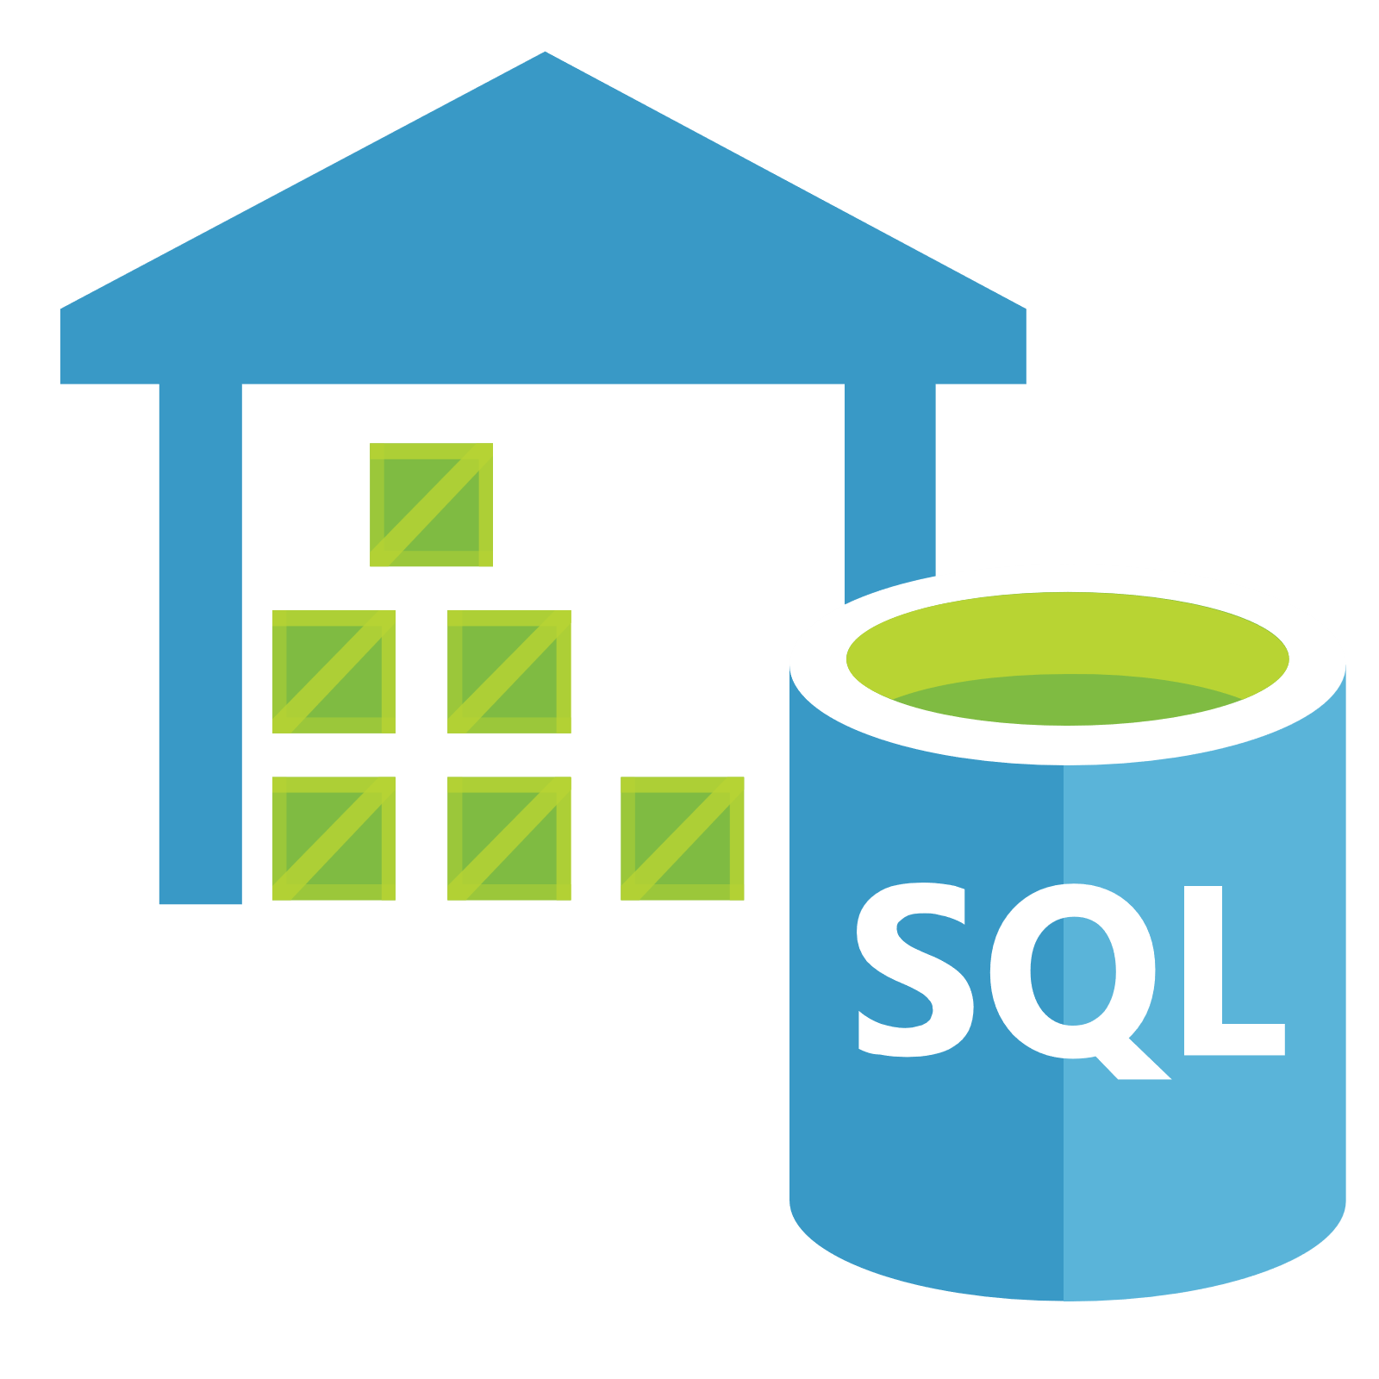

MOST Phase 1 - Data Flow Architecture Diagram
SAP finance and agency data will be pushed/uploaded to landing layer by local BU/corresponding team through flat files either manually or automatically that covered by the local BU project scope
MOST Platform
1
Azure Data Factory
ETL Movement & Transformation
SOURCE SYSTEM
Landing Layer
Raw Layer
Standardized Layer
Consumption Layer
2
Azure data factory will pick up the data from landing zone and to move data to raw layer for persistent keeping the raw file in data lake for use and historical record
AIA TH BU (AIA SSDC)
Visualization Layer
Agency data sources (through flat file )
6
3
Azure data factory will extract the agency data from raw layer to load it to agency data mart with proper data model & standard; Finance data will directly load to temporary database in consumption layer for reporting purpose (this is only temporarily needed in phase 1)
2
3
4
1
BU Management Users
SAP BPC (AIA SSDC)
5
AIA Finance data sources (through flat file )
Storage account (blob storage)
– Landing
Storage account(blob storage)
– Raw
Synapse – Data Mart
Synapse – Semantic Layer
Power BI
4
Agency data will then further transferred by data factory to semantic layer (a consumption layer) that ready for report to consume
3
Group Management Users
5
Power BI fetch the data from semantic layer for populating the reports/dashboard
Local and Group user view the dashboard in Power BI
Synapse – Temporary Data Mart for pilot (Semantic layer)
6
6
ETL Framework: Monitoring, Reconciliation, Auditing, Controlling

Slide 15
Network Design (reuse existing AIA network environment) Overall Network Diagram
The Azure infrastructure design for MOST is aimed to develop a solid architecture to support various infrastructure requirements of the MOST that includes the following major areas:
Network connectivity to support process
Network connectivity to support client connectivity the ETL
Alignment with AIA Group standard Azure networking model
Azure infrastructure for deploying the data presentation layer components of MOST which is Power BI deployed as SaaS

Slide 16
General Security Design Principles
The following security design principles are used in the security design:
Follow AIA Security Standards and TR security policies
Minimize attack surface area
Establish secure defaults
Least privilege
Defense in depth
Avoid security by obscurity
Keep security simple.
Separate privileges
Follow corporate standards
Leverage corporate identities instead of application-level identities.
Avoid using identities simply protected by password if better option is available (For example, use of Managed Identities of Azure resource to avoid use of password)

Slide 17
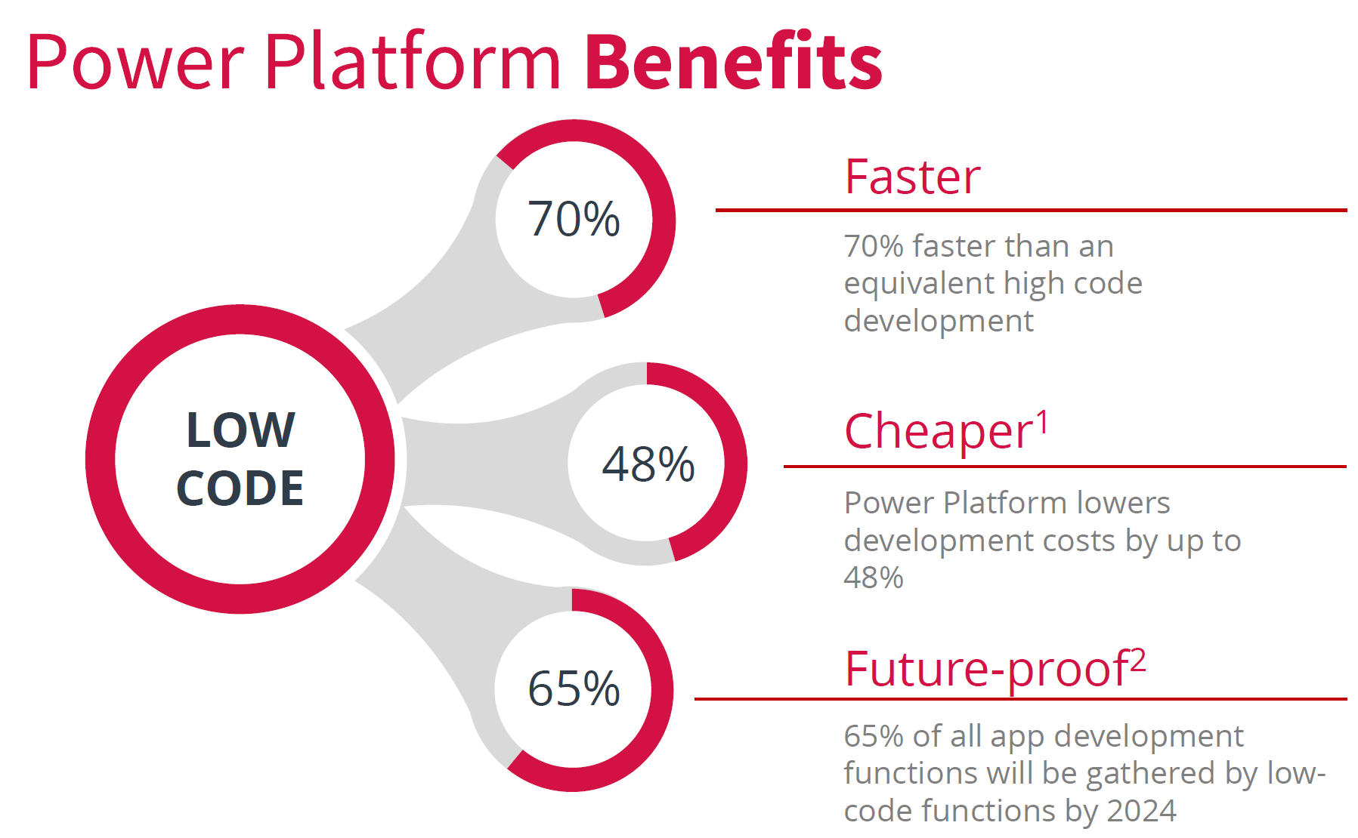
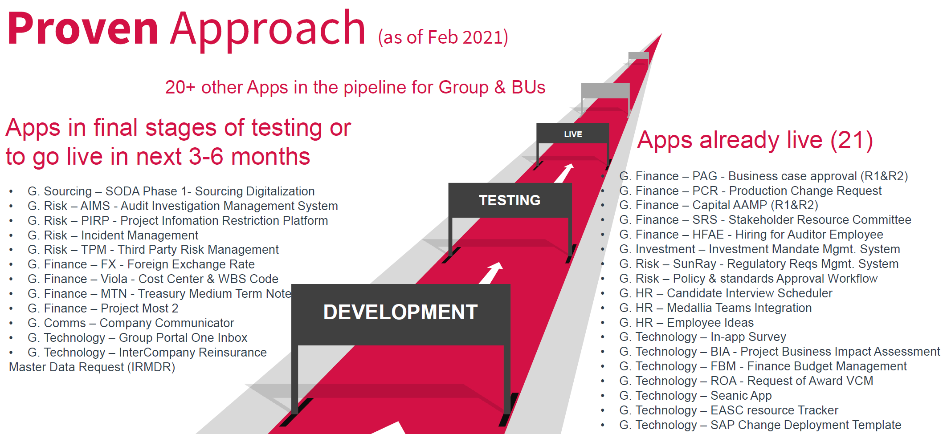
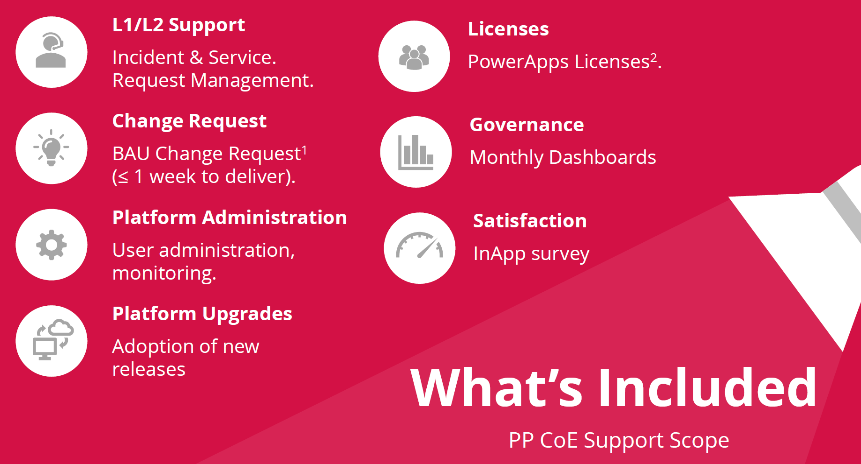
Power Platform

Slide 18
Definition of Key Terms
To help us get on the same page.
Users: Consists of Retail customers (Individual Life customers and non-AIA customers) and Corporate Solutions customers
PEP (Propositions, Ecosystem and Planning): Our next generation proposition development framework
Integrated digital experience: An engaging digital experience in a single app, with customer journeys connecting an ecosystem of offerings across AIA and partners
Super app: The best example of an integrated digital experience
Feature: A specific functionality within the app
Journey: The path of interactions users go through within the mobile app, that intuitively curates a range of associated features
Ecosystem: A connected network of products, services and offers provided by the business and its partners
Technology enablers: The supporting technology stack requirements to build the app
Minimum standards: A defined set of baseline features, customer journeys, and tech enablers to deliver an integrated digital experience
Release: Regular market launches iterated to introduce new features and journeys
18

Slide 19
Executive Summary
AIA needs to find a better way to engage users through our mobile app – to effectively execute on the Ascend strategy and exceed consumer expectations. To outpace competitors, AIA needs to deliver a leading future state mobile app and engagement model.
Our future state vision – is to create an elevated digital experience, that brings together an integrated ecosystem of services, that puts users at the center and drives key business benefits. This means focusing our efforts on moving towards a more integrated digital experience and journey-led ecosystem, and away from a feature-led consolidated app.
A two-step growth path has been developed to guide how the app should evolve – specifically an MVP based on minimum standards across features, customer journeys and tech enablers, and the Target State i.e. lifestyle super app. All BUs should strive to achieve the target state, no matter their starting point.
This will create clear benefits to our users, business and partners – and ultimately drive greater commercialisation through better engaging existing customers, enabling targeted acquisition of new customers, incremental insurance sales and opening up new partner revenue streams.
Minimum standards for an MVP have been clearly defined – across features, customer journeys and tech enablers. Market precedents and past AIA experience inform our app design to bring best practice, practical knowledge and on-the-ground GO/BU co-delivery experience to create a best-in-class app.
To move from design to execution, delivery capabilities have been defined – as the foundation to drive successful execution, i.e. a combined BU-GO structure, agile delivery model and technology architecture.
Next steps to move forward – include aligning on design for the mobile app, conduct/review capability assessment, conduct 'co-visioning and joint scoping' exercise to align on delivery activities, and identify any support required.
19

Slide 20


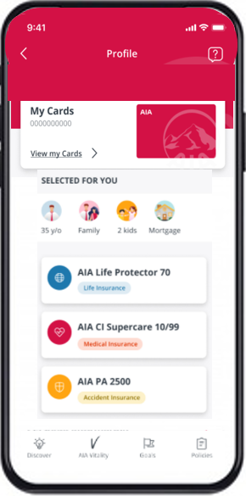



An integrated experience aligns with our Ascend growth expectations
Delivering our in-market offerings through an integrated digital experience enables us to drive deeper engagement with users and fully deliver on our brand promise.
Delivering an Integrated Digital Experience for our users
Enables Us To
Accelerate our leadership position by meeting the needs of (mass) affluent consumers
Delivers on our PEP framework so that we can compete through differentiated & compelling integrated protection propositions
Better engages our customers through an elevated experience that delivers the breadth of our ecosystem services and drives better shared-value outcomes
Acquire new user segments, and bring them into our ecosystem
AIA Vitality
Best-in-class
Features
Insurance Servicing
Integrated Customer Journeys
TDA Enablement
20

Slide 21
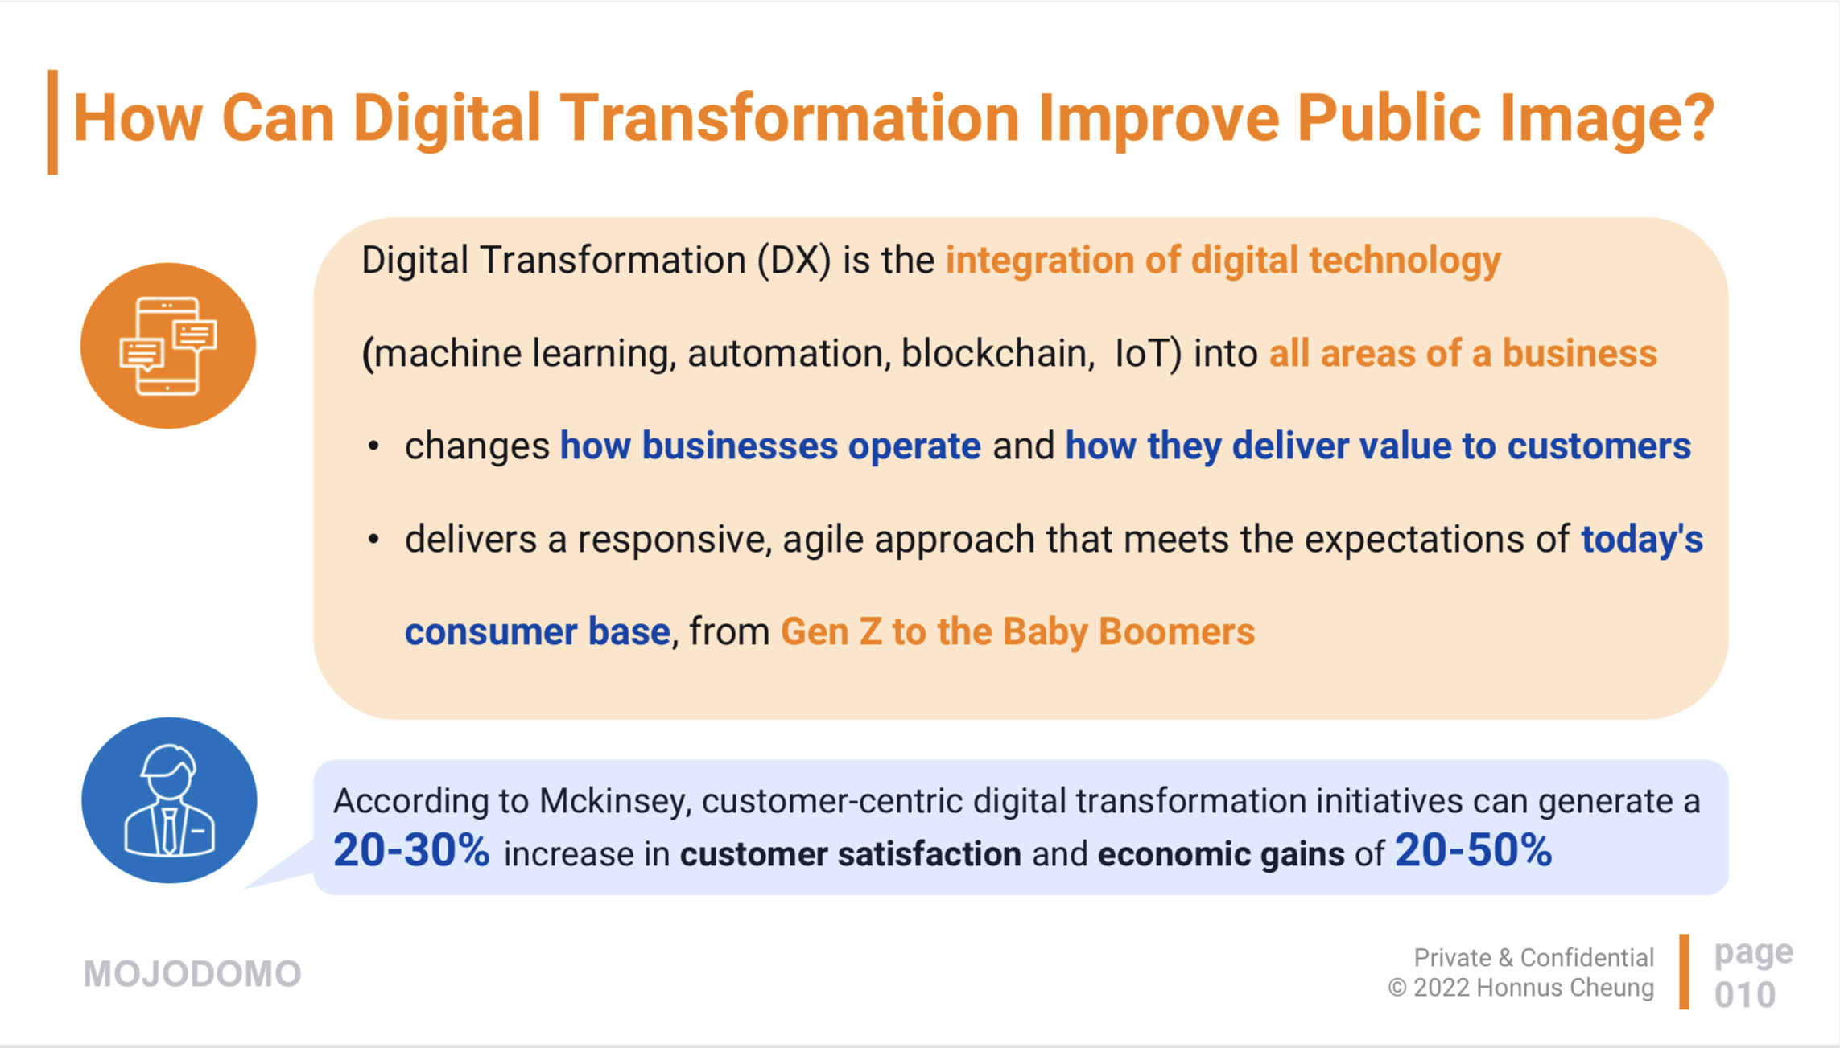
Customer Base
12:21 PM

Slide 22
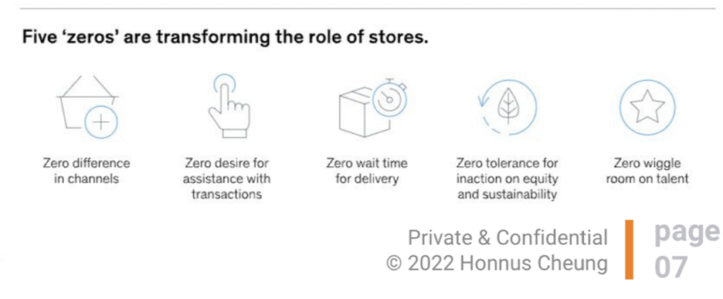
Calls to Action

Slide 23
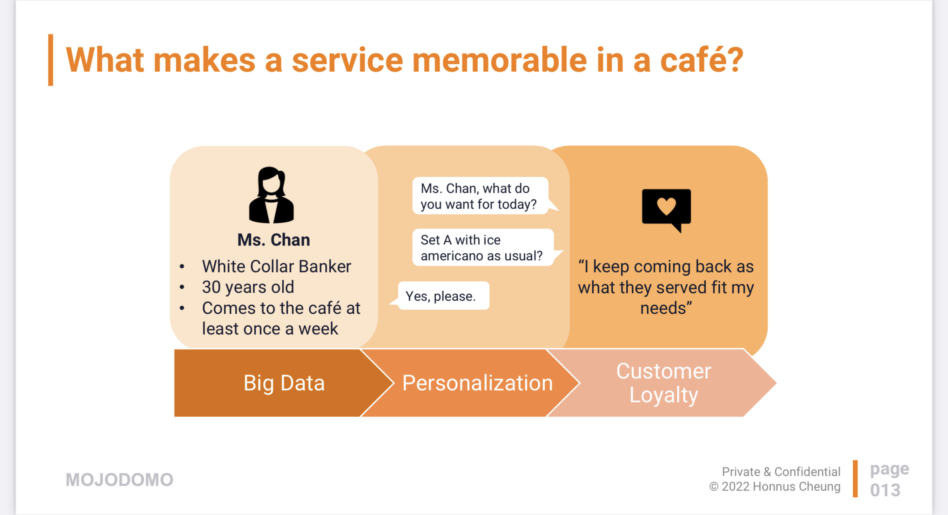
Service Memorable

Slide 24
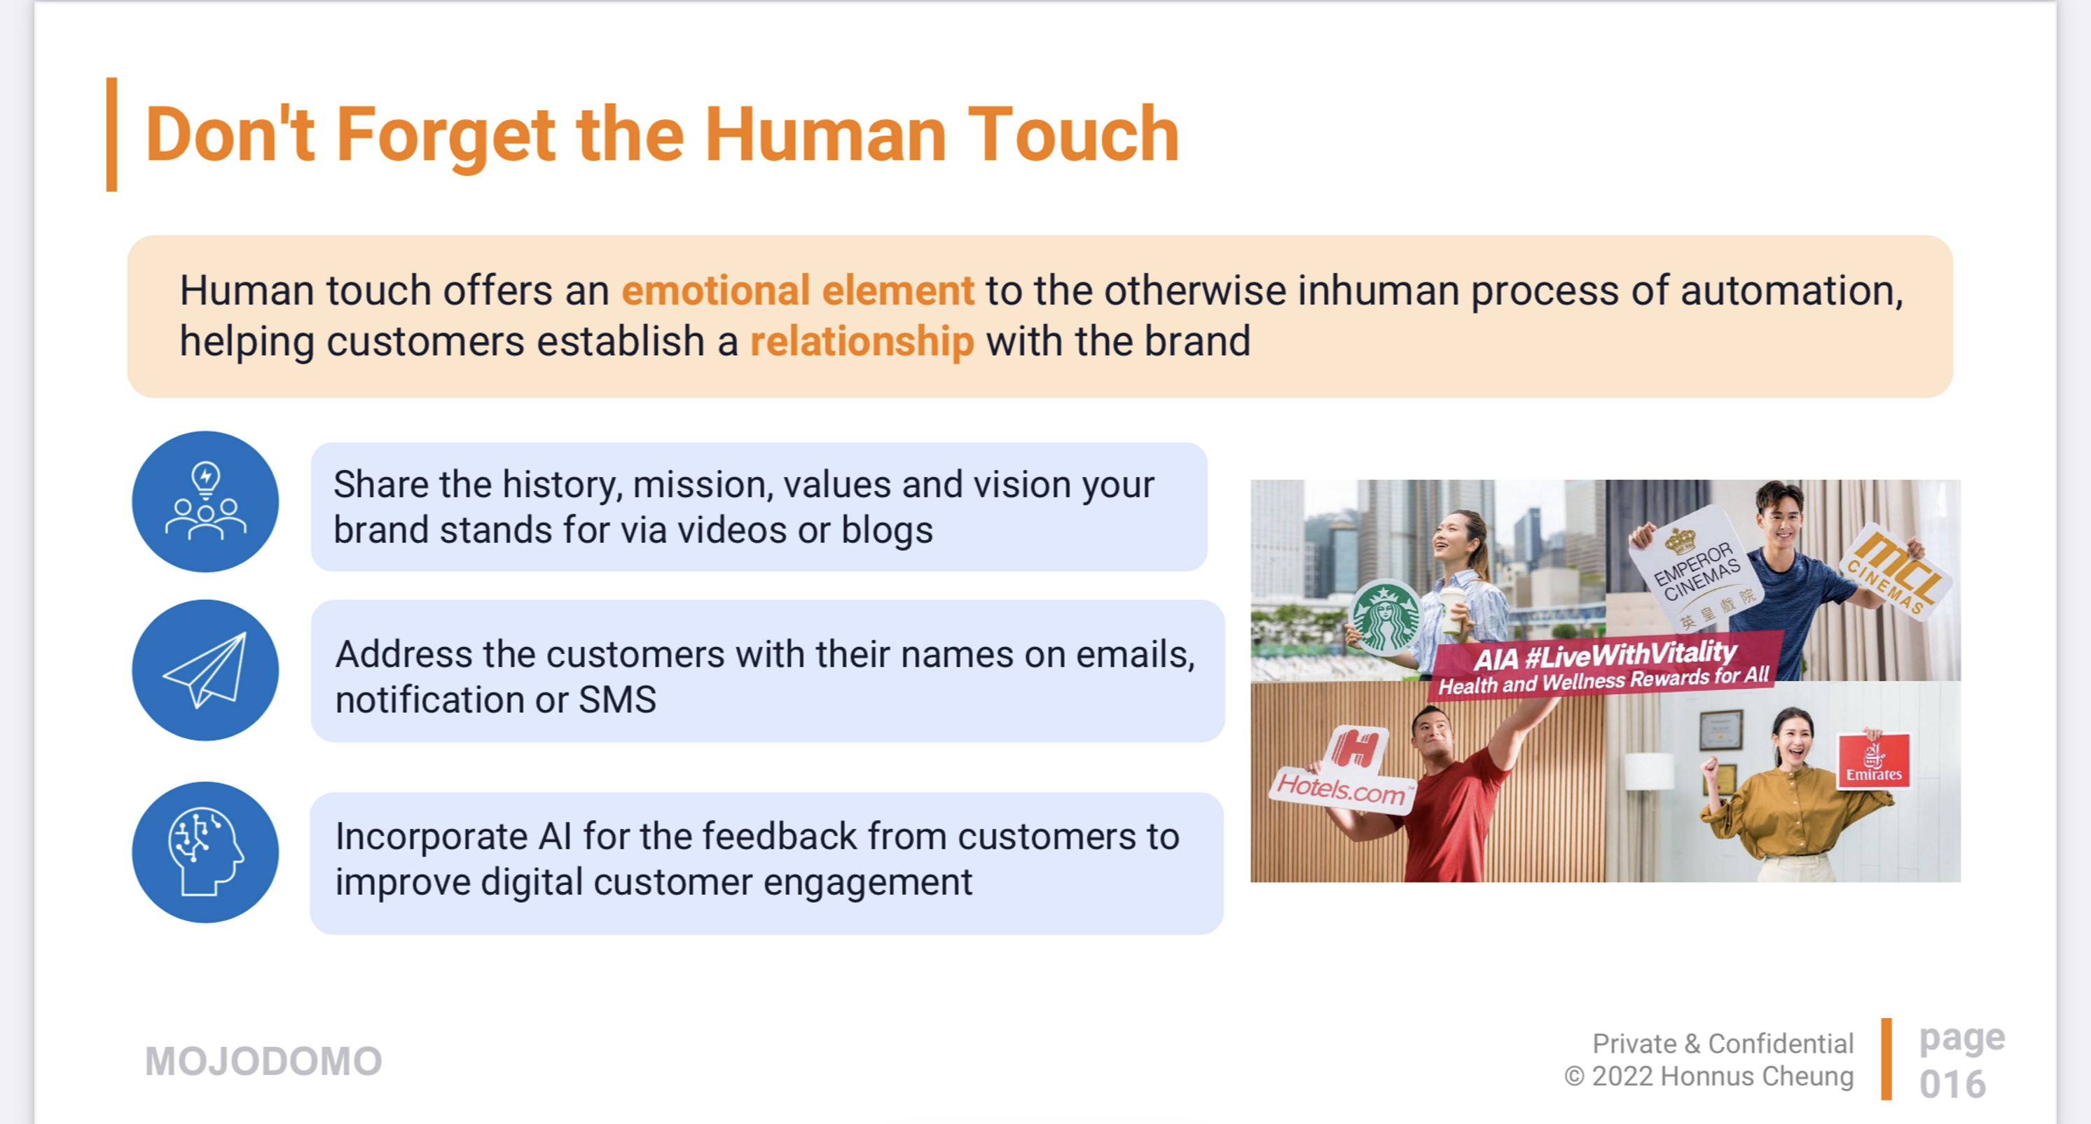
Human Touch

Slide 25
Minimum standards as a baseline, which sets the foundation for our target state
Once BUs have implemented the minimum standards in MVP, they can continue to design for the target state.
Design stage
MVP
TARGET STATE
Overview
MNIMUM STANDARDS
Integration of core journeys and features within our existing offering and partnerships
LIFESTYLE SUPER APP
Integration of additional journeys that extend beyond our existing offering and partnerships
Focus
Health & Wellness journeys as a priority
A hyper-personalised lifestyle ecosystem
Standards
Minimum standards defined, covering 32 features, 22 journeys and 25 tech enablers
Based on feature availability in BUs
Launched through phased-releases priortised by the BU
21 tech enablers defined
New features and journeys to be defined, e.g.:
Transportation services to a clinic for a check-up
Recommendations for healthy restaurants after a work-out
Push for bike sharing rental services for a short travel distance
Technology
Minimum tech architecture to enable some partnership connectivity, driven by AIA (closed ecosystem)
Full tech capability to enable the evolving ecosystem, i.e. connection of new services and partnerships by AIA (closed ecosystem) and/or partners (open ecosystem)
There can be multiple releases under each design stage
25

Slide 26
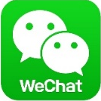

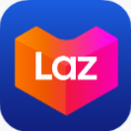



Success factors of leading integrated apps
These learnings from leading regional precedents have inspired our design choices for mobile app design.
Stay indispensable
Customer-led, integrated journeys
Have intuitive interfaces
Turn transactions into interactions
Evolve to stay relevant
Create new revenue streams
Through meeting a variety of customer needs through an ecosystem of services delivered through one front door
Stitch together key features across offerings, focused on delivering an end-to-end experience
Easy to understand and navigate, and consistent in design across the experience
Through focused engagement and customer communications, attracting new users and better engaging existing users
Enable evolution across the ecosystem with new products, services and partners to capitalise on new opportunities
Provide a holistic offering beyond their core industry based on what customers need, not just what they can sell
Examples
Ping An Health (previously Ping An Good Doctor)
WeChat
Gojek
Lazada
ZA Bank
Grab
Ultimate customer destination in China
User-centric and market specific features designed around local consumers
High discoverability and intuitive design on home screen and product pages
Gamifies every transaction and sends frequent push notifications with call-to-actions
Continuously evolving and expanding on its ecosystem to stay relevant
Incorporates multiple new services and revenue streams (e.g. clinics, pharmacies)
26

Slide 27





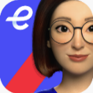

Learning from what didn’t go so well
Likewise, learning from where others could do better has further shaped our design choices and delivery focus.
Does not meet user needs
Fragmented offerings
Focused on features over customer journeys
Not engaging
Complacent
No new commercialisation opportunities
Not designed with the user but the business in mind, and sometimes difficult to complete tasks
Products and services provided in isolation, losing customer visibility and synergies
Deliver episodic customer touchpoints that lead nowhere
Lack of user communication and clear call-to-actions (CTAs) beyond a functional experience, failing to build greater relationships with customer
Not developed to evolve, leaving a stagnant app that loses its ability to properly provide the required functionality, let alone interest and engage customers
Through incorporating new products, services and partner offers
Examples
HSBC Mobile Banking, Reward+, PayMe
WeChat
Pulse by Prudential
AXA Emma
Fubon Bank
HSBC PayMe
Laundry list of products and services with no guided navigation
Fragmented apps offering products and services in isolation
Standalone features with no CTAs that drive commercial value
Key features are buried, e.g. health & wellness reward program
Dated design with no updates on offerings to meet changing customer needs
No commercialisation opportunities, limited to payment services
27

Slide 28
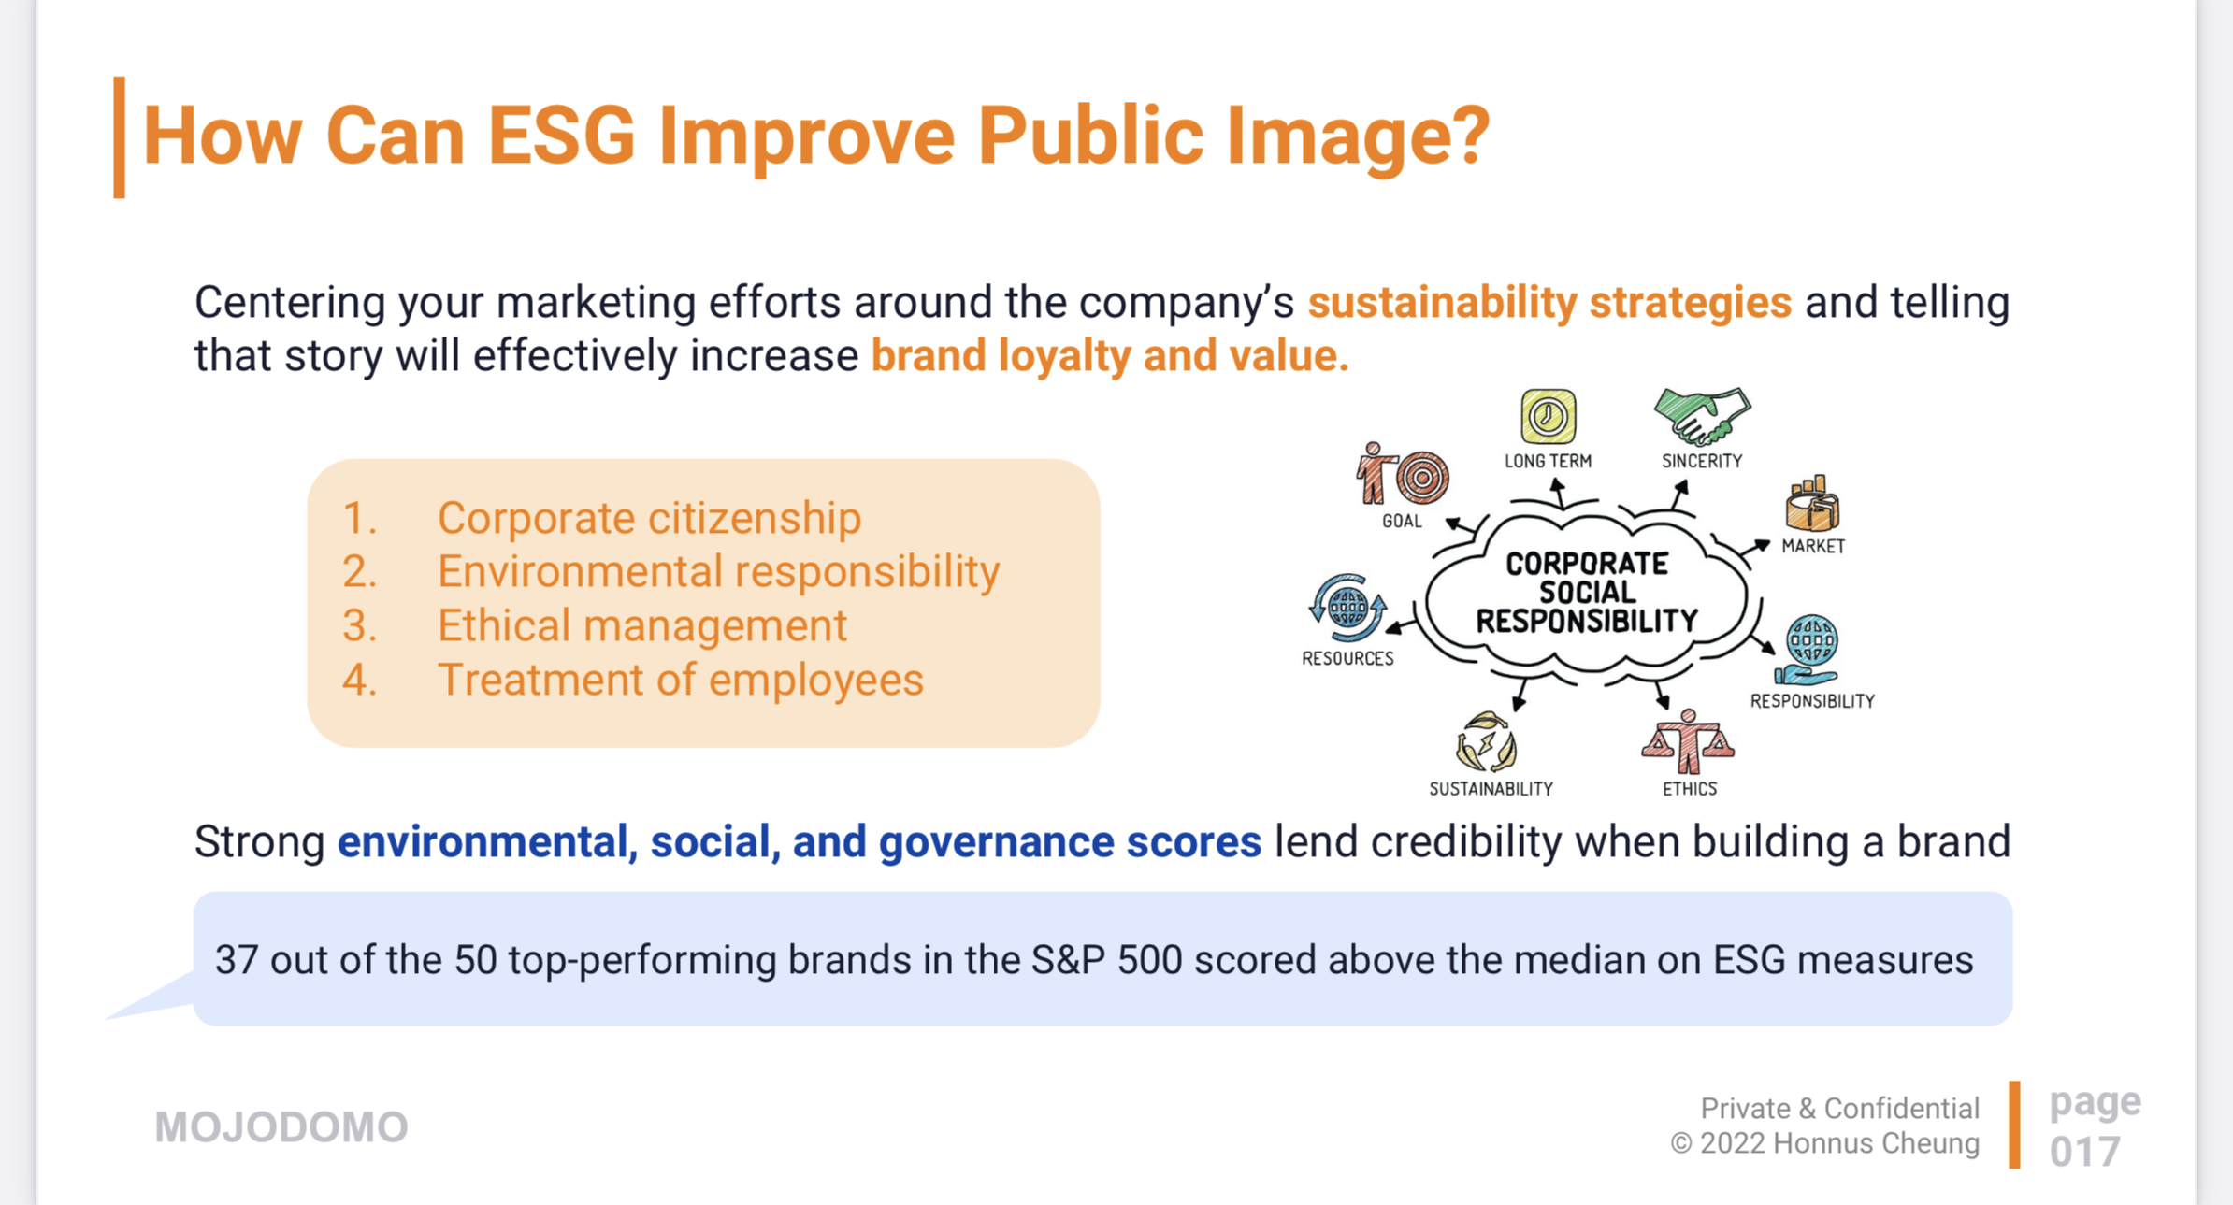
ESG

